Slide 1

Pilgrimage of Faith
1990 – 2021
A brief history of a Methodist Pilgrimage of Faith
regarding human sexuality

Slide 2
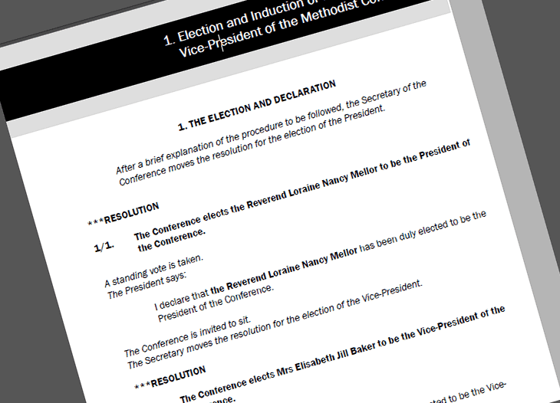
1990
Report of the Conference Commission on Human Sexuality
1992
The Conference Statement on a Christian understanding of Family Life, the Single Person and Marriage
Notes:
1990: Report of the Conference Commission on Human Sexuality
The full terms of reference for the Commission are :
to review the progress of the debate in the Conference and the connexion generally on the subject of human sexuality since 1976;
to take account of studies conducted by other churches, and the results of recent biblical, historical and scientific research available on the subject;
to consult widely in the connexion by whatever means seems appropriate;
to determine what degree of diversity of opinion and practice may in Christian conscience be permissible;
to make recommendations, as to personal lifestyle and corporate discipline, with reference to both members and those who hold office in the Church;
to include consideration of heterosexual and homosexual relationships and practice;
to report to the Conference of 1990.
1992: The Conference Statement on a Christian understanding of Family Life, the Single Person and Marriage
https://www.methodist.org.uk/media/2106/meth-statement-family-life-single-person-marriage-1992-0714.pdf

Slide 3

1993 Resolutions on Human Sexuality
The Conference, affirming the joy of human sexuality as God's gift and the place of every human being within the grace of God, recognises the responsibility that flows from this for us all. It therefore welcomes the serious, prayerful and sometimes costly consideration given to this issue by The Methodist Church.
Notes:
Following long debate at all levels of the Church's life on the basis of a detailed report written in 1990, the Conference debated the 1990 report and what emerged are know as the 1993 Resolutions. https://www.methodist.org.uk/about-us/the-methodist-church/views-of-the-church/human-sexuality-including-lgbtplus-issues/

Slide 4
1993 Resolutions on Human Sexuality
All practices of sexuality, which are promiscuous, exploitative or demeaning in any way are unacceptable forms of behaviour and contradict God's purpose for us all.
A person shall not be debarred from church on the grounds of sexual orientation in itself.
Notes:
Following long debate at all levels of the Church's life on the basis of a detailed report written in 1990, the Conference debated the 1990 report and what emerged are know as the 1993 Resolutions. https://www.methodist.org.uk/about-us/the-methodist-church/views-of-the-church/human-sexuality-including-lgbtplus-issues/

Slide 5
1993 Resolutions on Human Sexuality
The Conference reaffirms the traditional teaching of the Church on human sexuality; namely chastity for all outside marriage and fidelity within it. The Conference directs that this affirmation is made clear to all candidates for ministry, office and membership, and having established this, affirm that the existing procedures of our church are adequate to deal with all such cases.
Notes:
Following long debate at all levels of the Church's life on the basis of a detailed report written in 1990, the Conference debated the 1990 report and what emerged are know as the 1993 Resolutions. https://www.methodist.org.uk/about-us/the-methodist-church/views-of-the-church/human-sexuality-including-lgbtplus-issues/

Slide 6
1993 Resolutions on Human Sexuality
The Conference resolves that its decision in this debate shall not be used to form the basis of a disciplinary charge against any person in relation to conduct alleged to have taken place before such decisions were made.
Notes:
Following long debate at all levels of the Church's life on the basis of a detailed report written in 1990, the Conference debated the 1990 report and what emerged are know as the 1993 Resolutions. https://www.methodist.org.uk/about-us/the-methodist-church/views-of-the-church/human-sexuality-including-lgbtplus-issues/

Slide 7
1993 Resolutions on Human Sexuality
Conference recognises, affirms and celebrates the participation and ministry of lesbians and gay men in the church. Conference calls on the Methodist people to begin a pilgrimage of faith to combat repression and discrimination, to work for justice and human rights and to give dignity and worth to people whatever their sexuality.
Notes:
Following long debate at all levels of the Church's life on the basis of a detailed report written in 1990, the Conference debated the 1990 report and what emerged are know as the 1993 Resolutions. https://www.methodist.org.uk/about-us/the-methodist-church/views-of-the-church/human-sexuality-including-lgbtplus-issues/

Slide 8
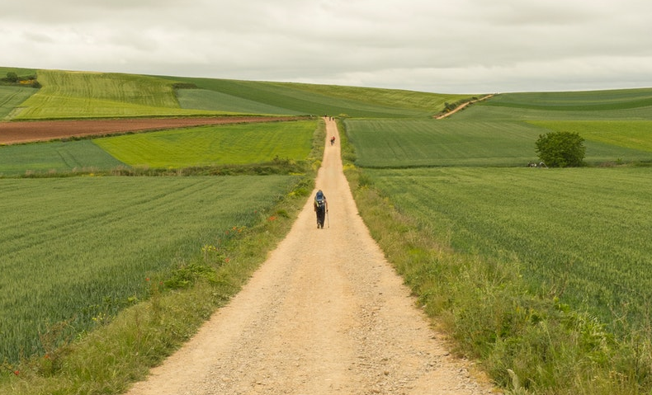
The Pilgrimage of Faith
1998
Preparing for Marriage, including a further discussion of the 1993 resolutions
2005
Pilgrimage of Faith – more work to do/start; reaffirmation of 1993 Resolutions
Notes:
https://www.methodist.org.uk/about-us/the-methodist-church/views-of-the-church/human-sexuality-including-lgbtplus-issues/

Slide 9
The Pilgrimage of Faith
2006
Living with Contradictory Convictions paper
2006
Pilgrimage of Faith – members and ministers may enter civil partnerships; no services of blessing on our premises
Notes:
https://www.methodist.org.uk/about-us/the-methodist-church/views-of-the-church/human-sexuality-including-lgbtplus-issues/
A model statement on Living with Contradictory Convictions (methodist.org.uk)

Slide 10
The Pilgrimage of Faith
2007
Review of the 1993 resolutions on Human Sexuality
2014
Marriage & Civil Partnerships – members and ministers may marry those of same sex; no opt-in to Marriage Equality legislation but prayers allowed on our premises
Notes:
https://www.methodist.org.uk/about-us/the-methodist-church/views-of-the-church/human-sexuality-including-lgbtplus-issues/

Slide 11
The Pilgrimage of Faith
2015
Homophobia Definition and Guidance - A resource produced by the Equality Diversity and Inclusion Committee
Notes:
https://www.methodist.org.uk/media/2089/7-1-1-sexual-orientation-homophobia-guidance.pdf

Slide 12
God in Love Unites Us
Marriage and Relationships Report (2019)
Provisional Legislation
Mixed economy approach
Marriage defined as one man one woman or two people
Celebration of civil partnerships
Conscience clause for ministers
Conscience clause for managing trustees to register for same-sex marriages or not
Notes:
The 2018 Conference directed the Marriage and Relationships Task Group to bring a report to the Conference in 2019 setting out a number of theological arguments and recommendations concerning the most pressing issues in the Church’s understanding of relationships and marriage.
The Conference also adopted a Notice of Motion which directed the Task Group to ensure that the recommendations to be brought to the Conference include options for “a way forward that is consistent with the existing commitment to live with contradictory convictions” and enable, amongst other things, “those who feel called by God to solemnise same sex marriages to do so” and “protection for ministers, probationers, members and churches prevented by conscience from participation in such services”.

Slide 13
God in Love Unites Us
cohabitation
Marriage and Relationships Report (2021)
“The Conference affirms the following summary understanding of cohabitation: The Church recognises that the love of God is present within the love of two human beings who are drawn to each other, and who enter freely into some form of life-enhancing committed relationship with each other, whether that be through informal cohabitation or a more formal commitment entered into publicly.”
Notes:
The Conference confirmed provisional resolutions made in 2019, one of which regards cohabition and one regards same sex weddings
The Conference affirms the following summary understanding of cohabitation: ● The Church recognises that the love of God is present within the love of human beings who are drawn to each other, and who enter freely into some form of life-enhancing committed relationship with each other, whether that be through informal cohabitation or a more formal commitment entered into publicly. ● As a Church we wish to celebrate that the love of God is present in these circumstances, even if that grace is not responded to or even discerned by the people concerned. ● The Church has an important calling, therefore, to point to the presence of God’s love within such relationships, and to encourage people to respond to it in the renewing and deepening (by whatever means) of their commitment.
For confirmation of the definitive statement text, see Book VII, Part 10 of CPD: conf-2021-cpd-vol-2.pdf (methodist.org.uk)

Slide 14
God in Love Unites Us
cohabitation
Marriage and Relationships Report (2021)
“As a Church we wish to celebrate that the love of God is present in these circumstances, even if that grace is not responded to or even discerned by the people concerned.
The Church has an important calling, therefore, to point to the presence of God’s love within such relationships, and to encourage people to respond to it in the renewing and deepening (by whatever means) of their commitment.”

Slide 15
God in Love Unites Us
same-sex marriage
Marriage and Relationships Report (2021)
“The conference consents in principle to the marriage of same-sex couples on Methodist premises throughout the Connexion and by Methodist ministers, probationers or members in so far as the law of the relevant jurisdiction permits or requites and subject to compliance with such further requirements, if any, as that law imposes.”
Notes:
https://www.methodist.org.uk/about-us/news/latest-news/all-news/conference-confirms-resolutions-on-marriage-and-relationships/
Note: the language on the slide is the exact language in the report. The conference also accepted Notice of Motion from Scotland re language as it is not buildings that are registered in Scotland. (There are other differences in Isle of Man, Jersey and Guernsey). Therefore the language we are now using is to register/make available premises for same-sex weddings
Another thing to note is that nothing agreed is a change to doctrine. Part C of the 2021 Report Methodist Doctine and Discipline makes clear that “The Methodist Conference has stated that the doctrinal standards are not articulated in a “finite and comprehensive
statement but are set out in Clause 4 of the Deed of Union”
Clause 4 says
The doctrinal standards of the Methodist Church, as set out in Clause 4 of the Deed of Union are as follows:
“The Methodist Church claims and cherishes its place in the Holy Catholic Church which is the Body of Christ. It rejoices in the inheritance of the apostolic faith and loyally accepts the fundamental principles of the historic creeds and of the Protestant Reformation. It ever remembers that in the providence of God Methodism was raised up to spread scriptural holiness through the land by the proclamation of the evangelical faith and declares its unfaltering resolve to be true to its divinely appointed mission.
The doctrines of the evangelical faith which Methodism has held from the beginning and still holds are based upon the divine revelation recorded in the Holy Scriptures. The Methodist Church acknowledges this revelation as the supreme rule of faith and practice. These evangelical doctrines to which the preachers of the Methodist Church are pledged are contained in Wesley’s Notes on the New Testament and the first four volumes of his sermons.
The Notes on the New Testament and the 44 Sermons are not intended to impose a system of formal or speculative theology on Methodist preachers, but to set up standards of preaching and belief which should secure loyalty to the fundamental truths of the gospel of redemption and ensure the continued witness of the Church to the realities of the Christian experience of salvation.”1

Slide 16

2021
The Conference voted to ban Conversion Therapy
Notes:
https://www.methodist.org.uk/about-us/news/latest-news/all-news/methodist-conference-votes-on-banning-of-conversion-therapy/

Slide 17

What now?
Methodist ministers, probationers and any member the law allows to conduct weddings, can choose if they do or not want to officiate at same-sex weddings as a Methodist representative.

Slide 18
What now?
All Methodist Trustees (Church Councils) are now able to vote to decide if they do, or do not, want to register / make available their premises for same-sex weddings.
All Methodists are asked to work through what it is means to live with contradictory convictions.
Notes:
Note: if any non-Methodist congregation uses a Methodist building for regular worship, then the non-Methodist congregation’s consent to the registration of the building (England) for same-sex marriage will also be required, even if that congregation does not intend using the building for that purpose.

